Slide 1

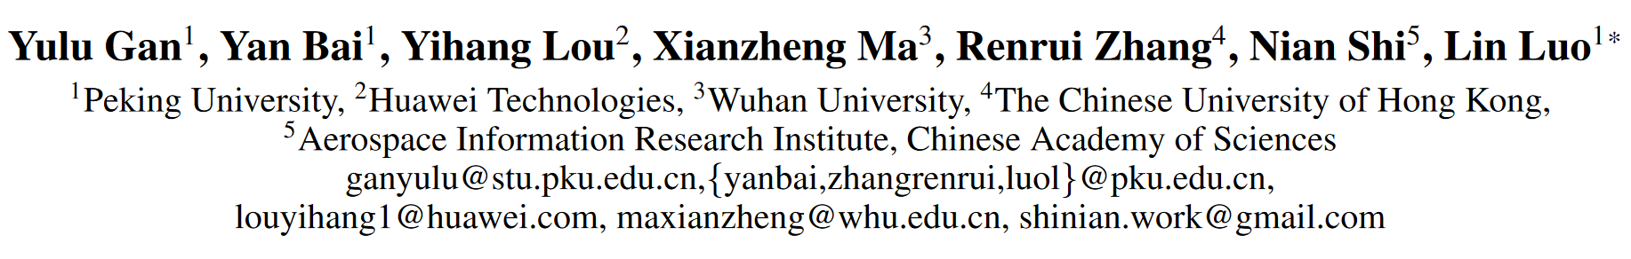
Decorate the Newcomers: Visual Domain Prompt for Continual Test Time Adaptation
AAAI 2023

Slide 2

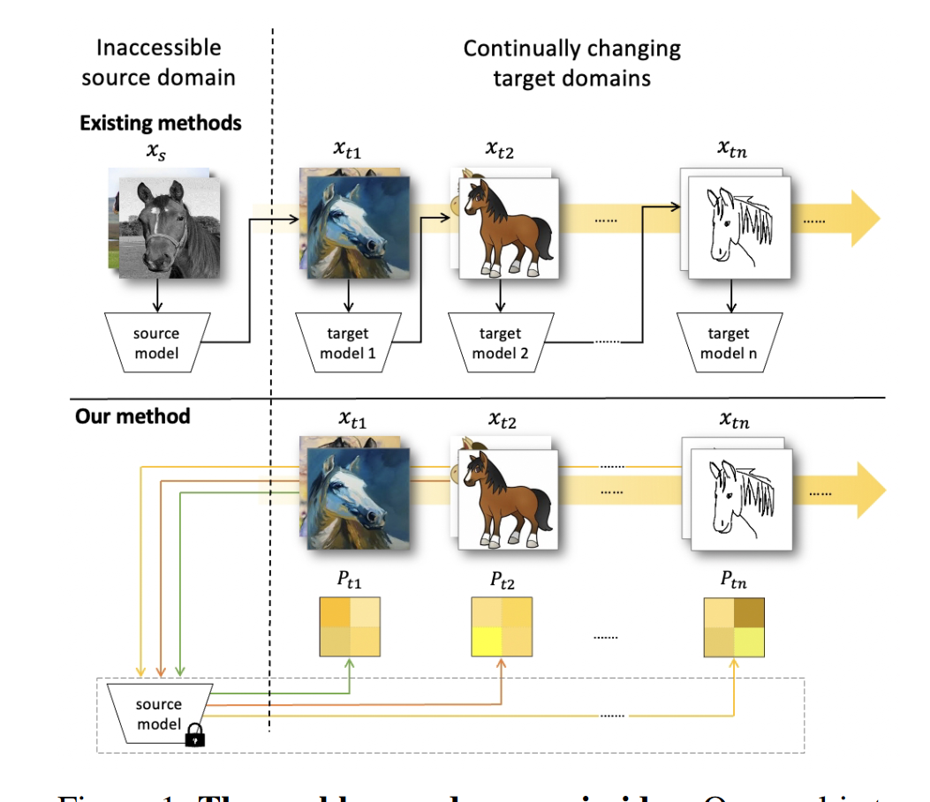
Background
Continual Test-Time Adaptation
Previous methods
Focus on model-based adaptation
This work
Tuning the visual prompts for each domain
Reformulating the input data with learned prompts

Slide 3
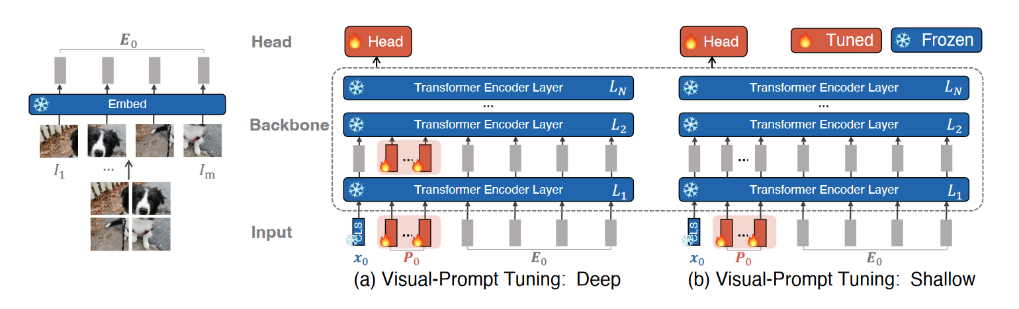
Background
Traditional visual prompts
Visual Prompt Tuning. ECCV 2022

Slide 4
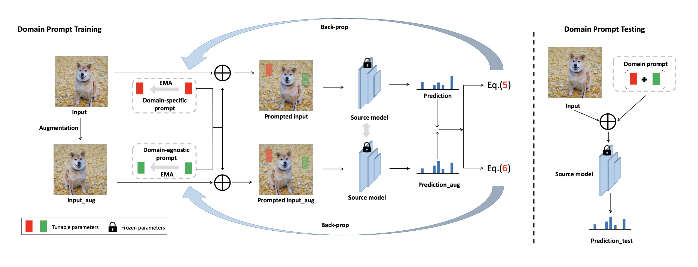
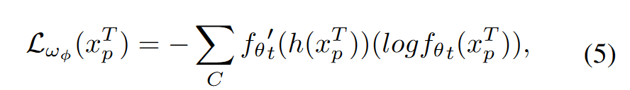
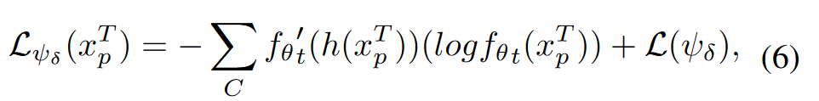
Methods
The whole framework
Domain-specific prompts
Domain-agnostic prompts

Slide 5
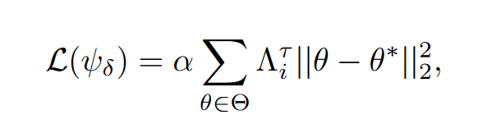
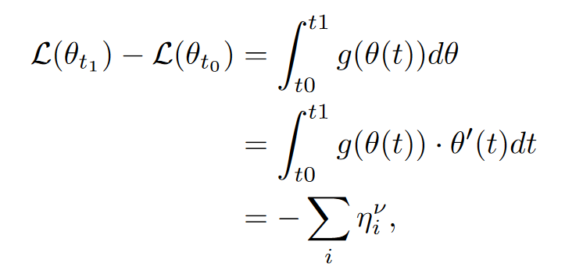
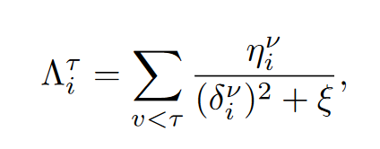
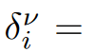
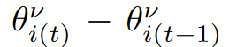
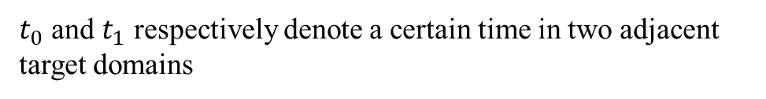
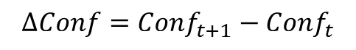
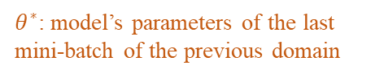
Methods
Limiting domain-sensitive parameters’ update
$θ^{∗}$: model’s parameters of the last mini-batch of the previous domain
Domain-shift detection
$$ΔConf=Conf_{t+1}−Conf_{t}$$
→ How to measure parameters’ sensitivity toward domain shift?
Threshold S=0.25
$t_{0}$ and $t_{1}$ respectively denote a certain time in two adjacent target domains
Inter-domain change
The homeostatic factor
Intra-domain change

Slide 6
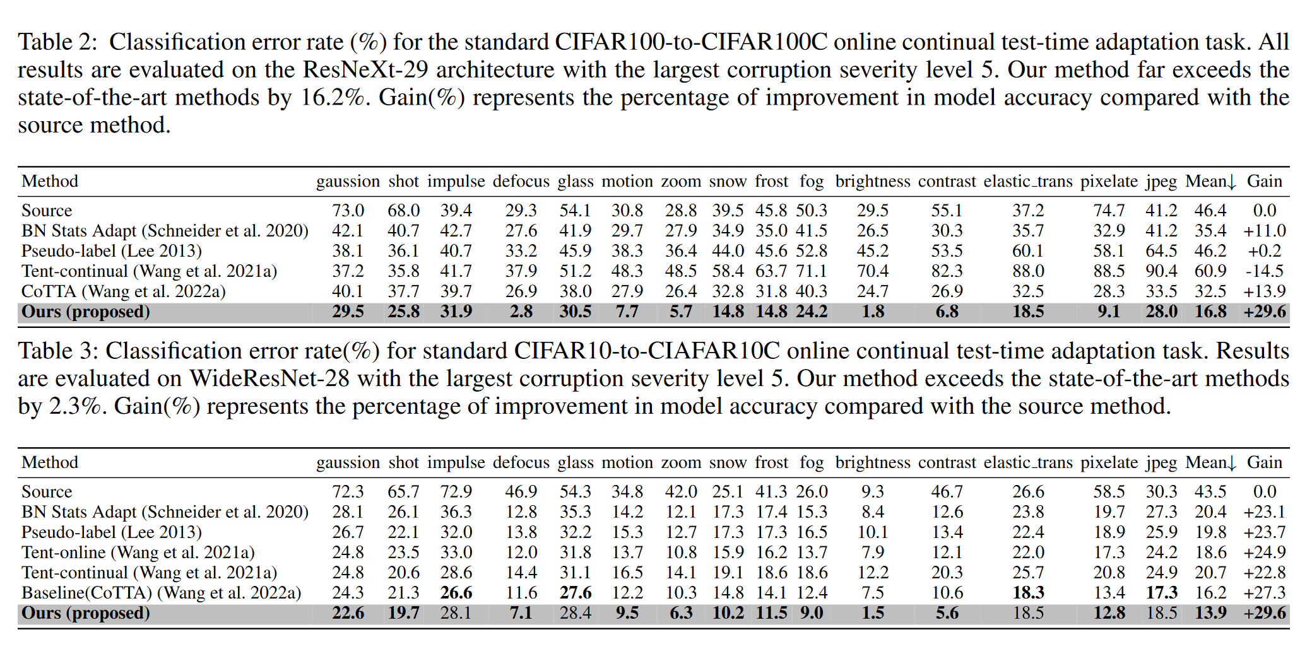
Experiments

Slide 7
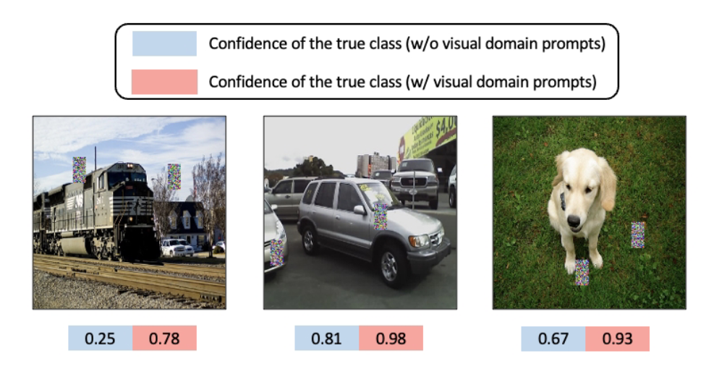
Experiments

Slide 8
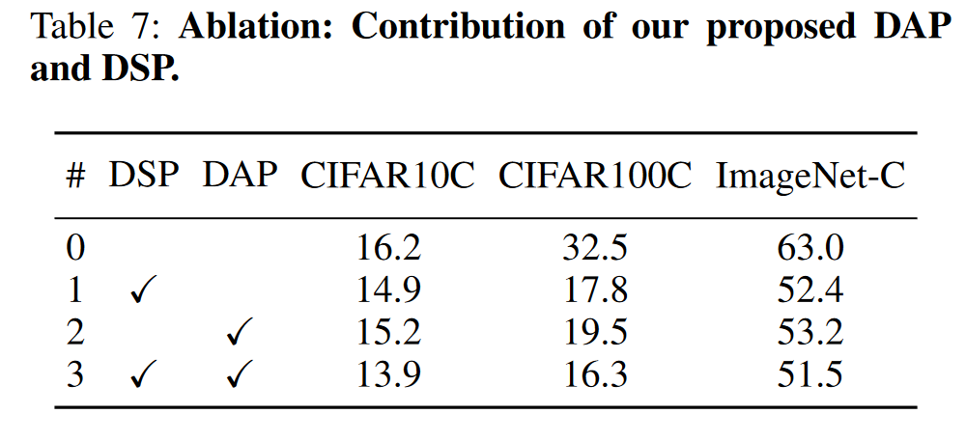
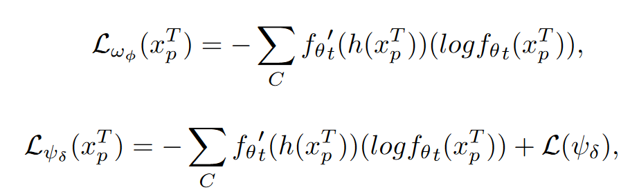
Experiments

Slide 9
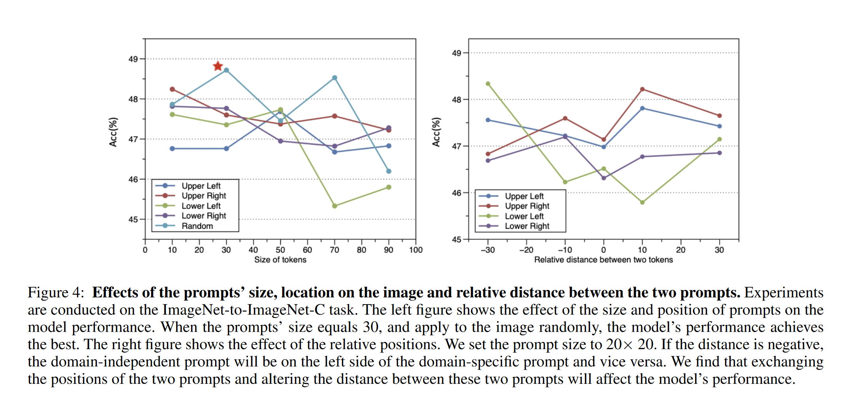
Experiments

Slide 10
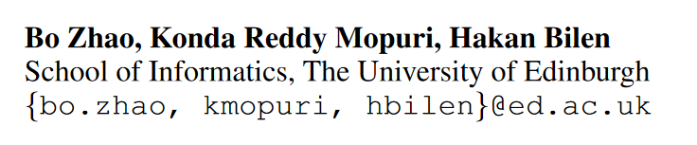
Dataset Condensation with Gradient Matching
ICLR 2021

Slide 11
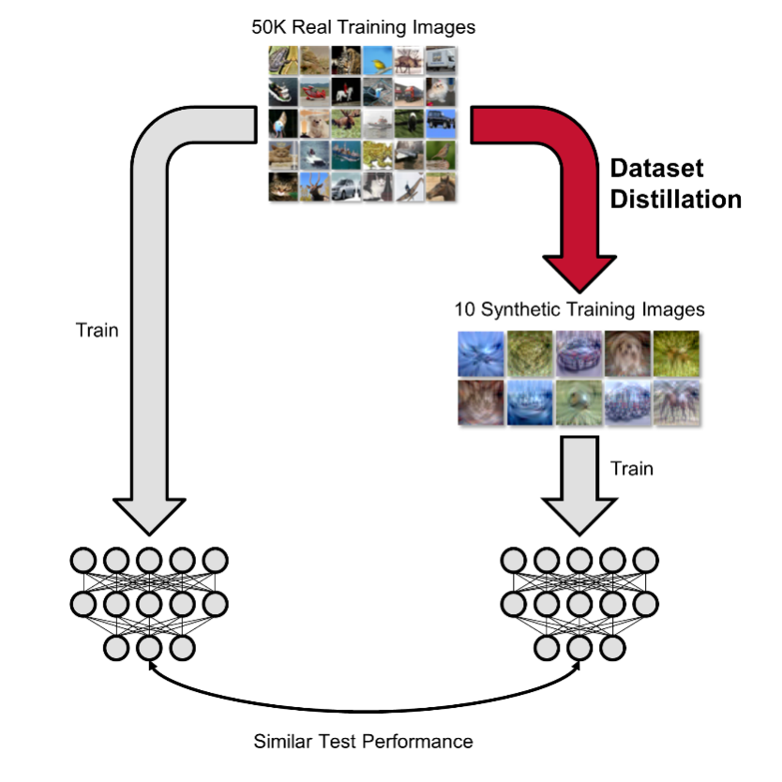
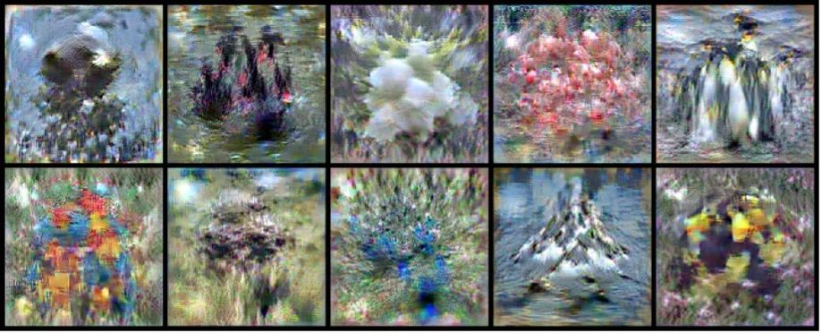
Background
Dataset Distillation
Task: Synthesizing small datasets such that models trained on them achieve comparable performance to the original large dataset.

Slide 12
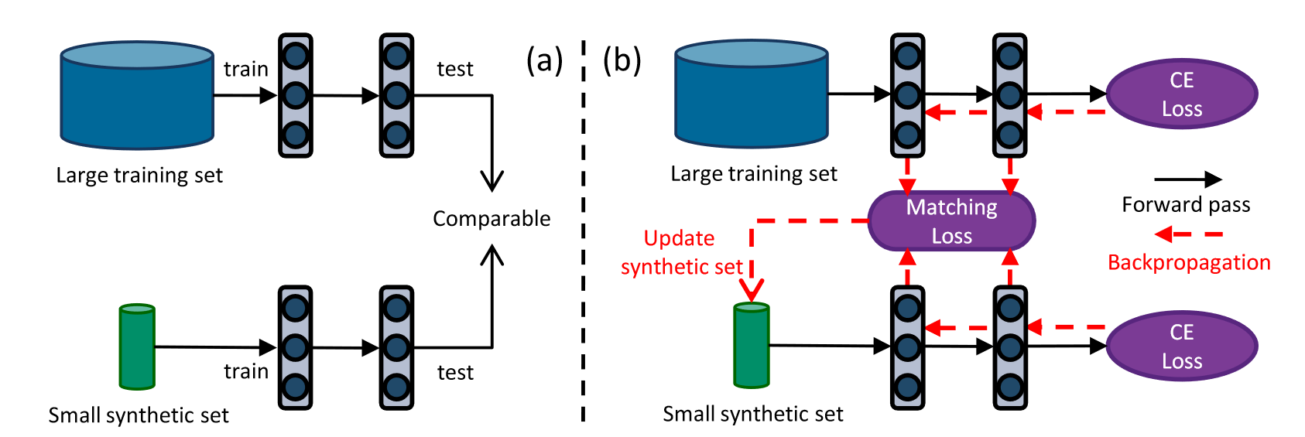
Methods
The whole framework

Slide 13
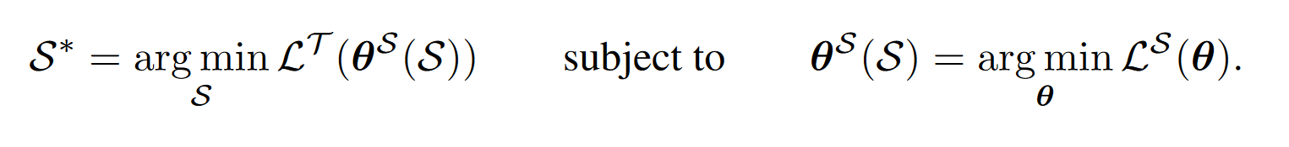
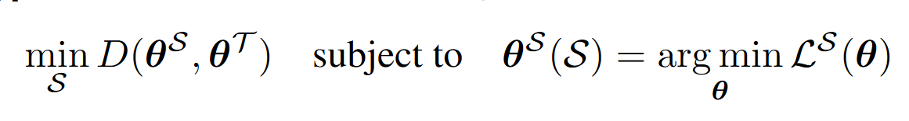
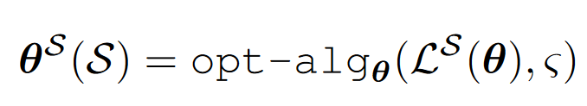
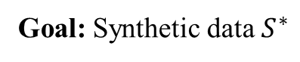
Methods
Goal: Synthetic data $S^{∗}$
Parameter Matching
Similar weights imply similar mappings in a local neighborhood and thus generalization performance
To generate samples that can work with a distribution of random initializations
Re-defines $θ^{S}$ as the output of an incomplete optimization
Justin Domke. Generic methods for optimization-based modeling. In Artificial Intelligence and Statistics. 2012.

Slide 14
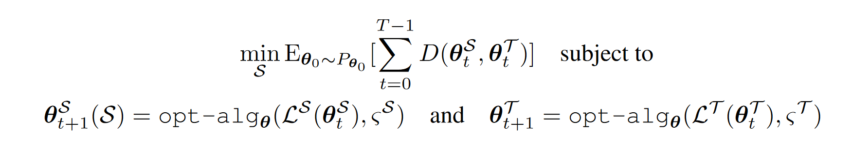
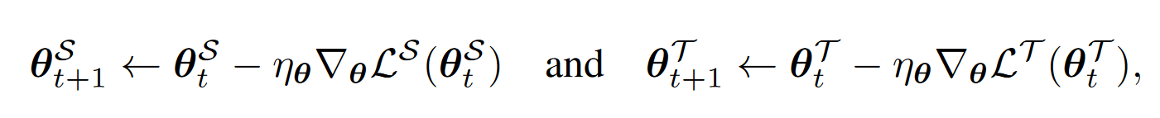
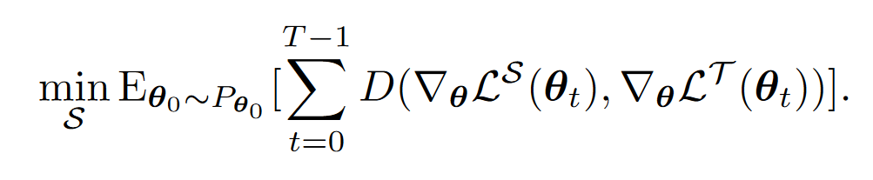
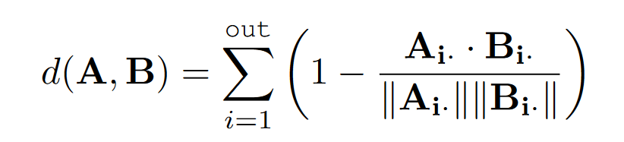
Methods
Curriculum Gradient Matching
Let $θ^{S}$ follow a similar path to $θ^{T}$ throughout the optimization
Minimize the distance between the gradients

Slide 15
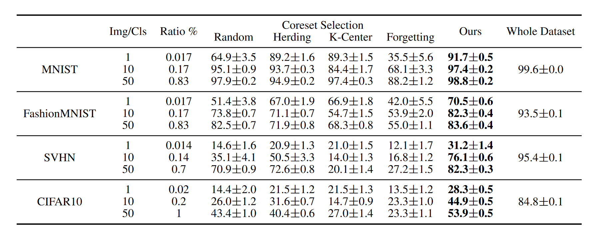
Experiments

Slide 16
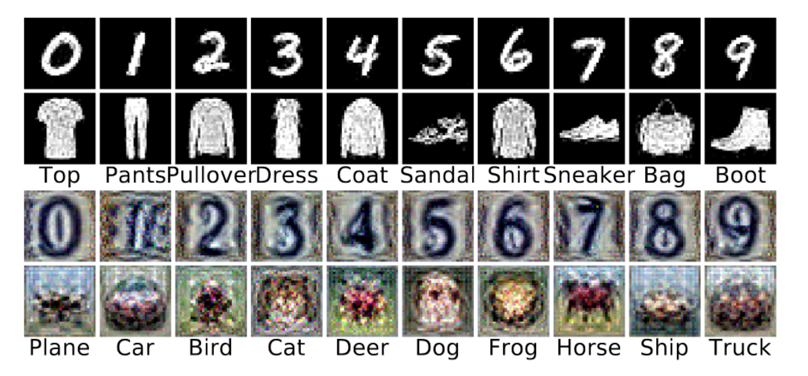
Experiments

Slide 17
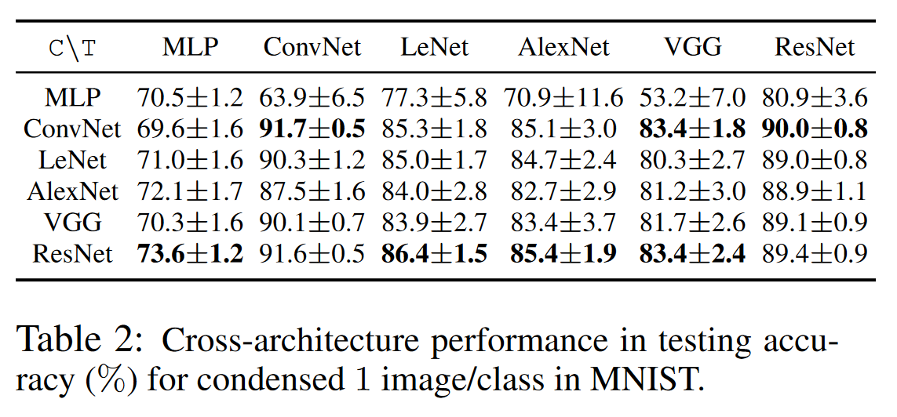
Experiments

Slide 18

Thanks

